Slide 1

jn telliPaat
Python Tutorial for Beginners

Slide 2
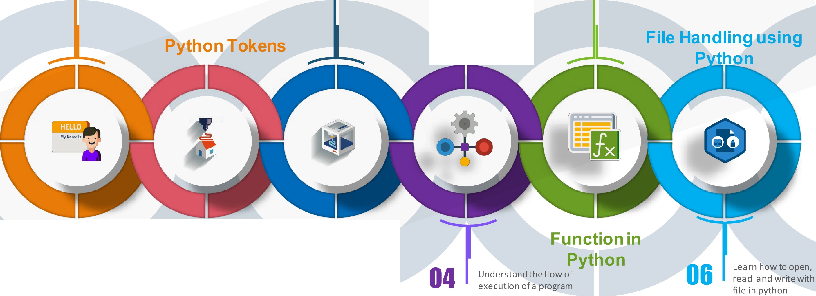

Agenda for
jn telliPaat
Today's Session
01
Get a brief understanding of what exactly is Python
03
Learn and implement various data types in python
05
Understand how to define and call a function in python
Flow Control
Introduction to Python
3.0
Data Types in Python
02 Learn a bout Keywords, Identifiers, Lit era Is and Operators
www.inte11ipaat.com

Slide 3
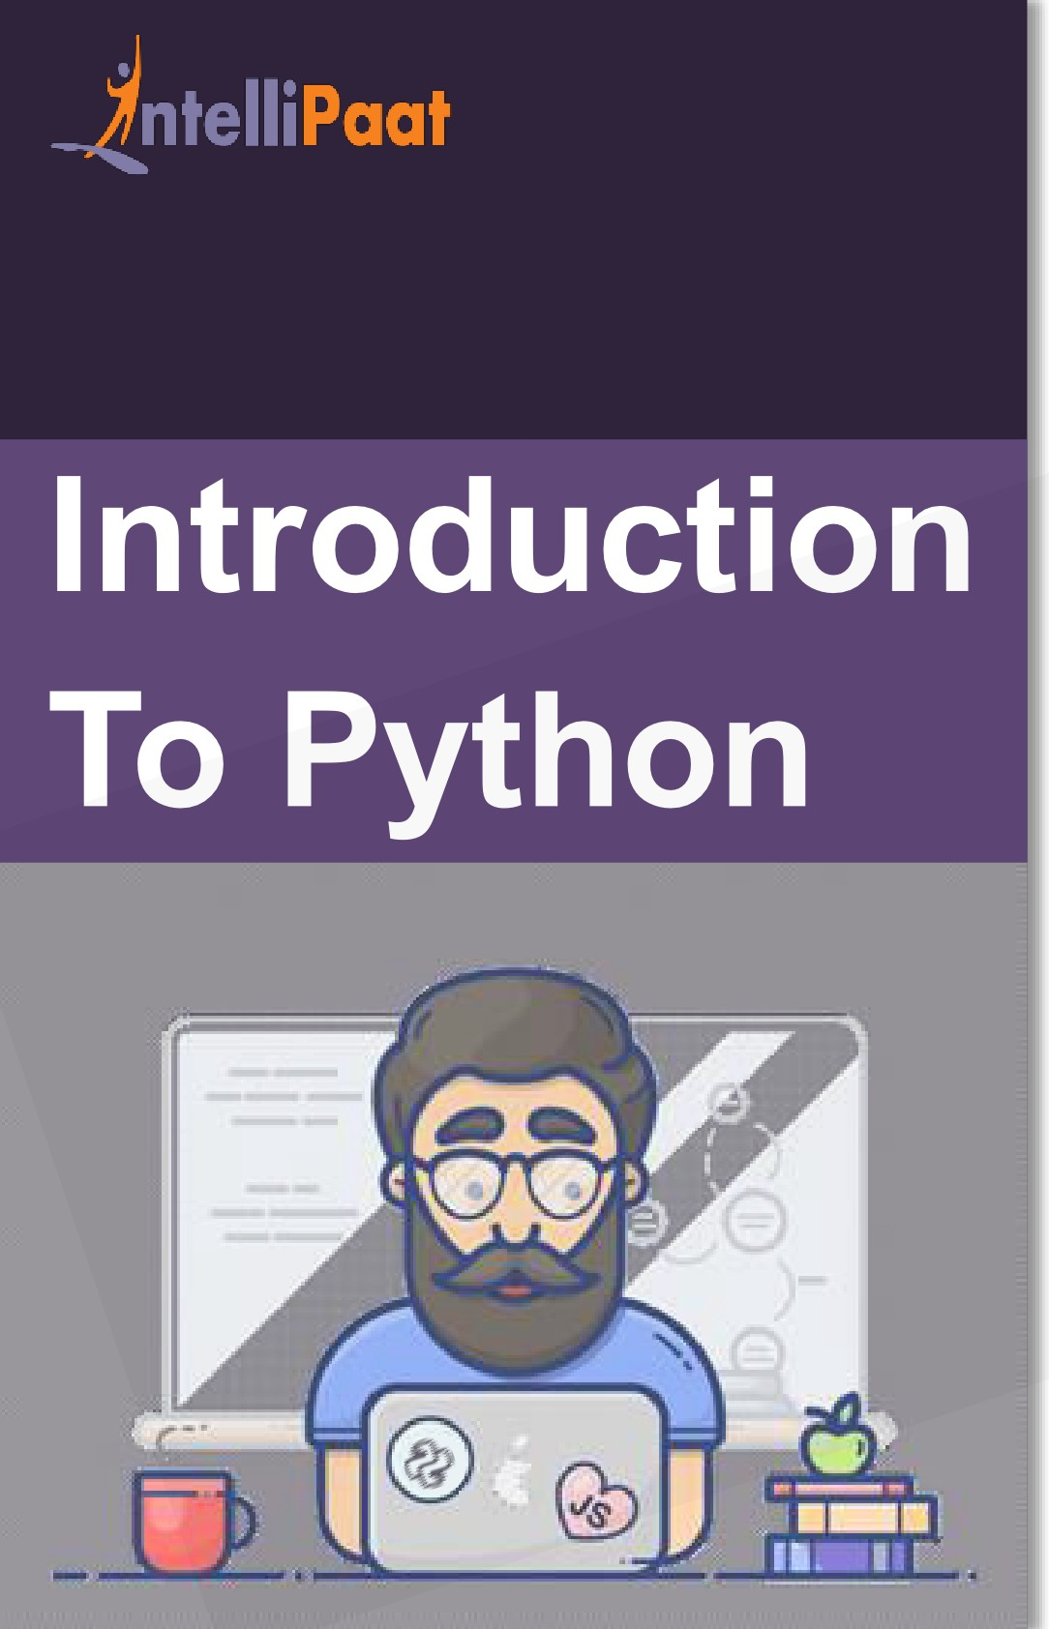


Do you know who created Python?
Created in 1991 by Guido van Rossum
www.inte11ipaat.com

Slide 4



_ j nteIiiPaat
Ever1 wondered Why is it named Python?
Introduction
To Python
- - -- - . .. ..
a • m. -
1 -
• -
I
Ii ·
. iiii■
Named after Monty's Python Flying Circus
www.inte11ipaat.com

Slide 5



Why should YOU learn Python?
Large open
source
Reliable and
community
Career
Efficient
Opportunity
Extensive
Simple and
Library
Easy to learn
www.inte11ipaat.com

Slide 6


_ j nteIiiPaat
Python can be used in lot of places...
Introductio
n
Hardware Programming
Raspberry Pi
'
- - - -
To Python
Machine Learning, DS,
Deep Learning
sklearn, tensorflow, theano,
Spark
03
Cloud and DevOps
OpenStack APls, Fabric
WebApplicatior 01 CJ)
Django, Flask, Tornado
Desktop Application
PyGTK, Cocoa
www.inte11ipaat.com

Slide 7

































Popularity of Python in Industry…
Introduction To Python
www.intellipaat.com

Slide 8


Installing Python
www.intellipaat.com

Slide 9
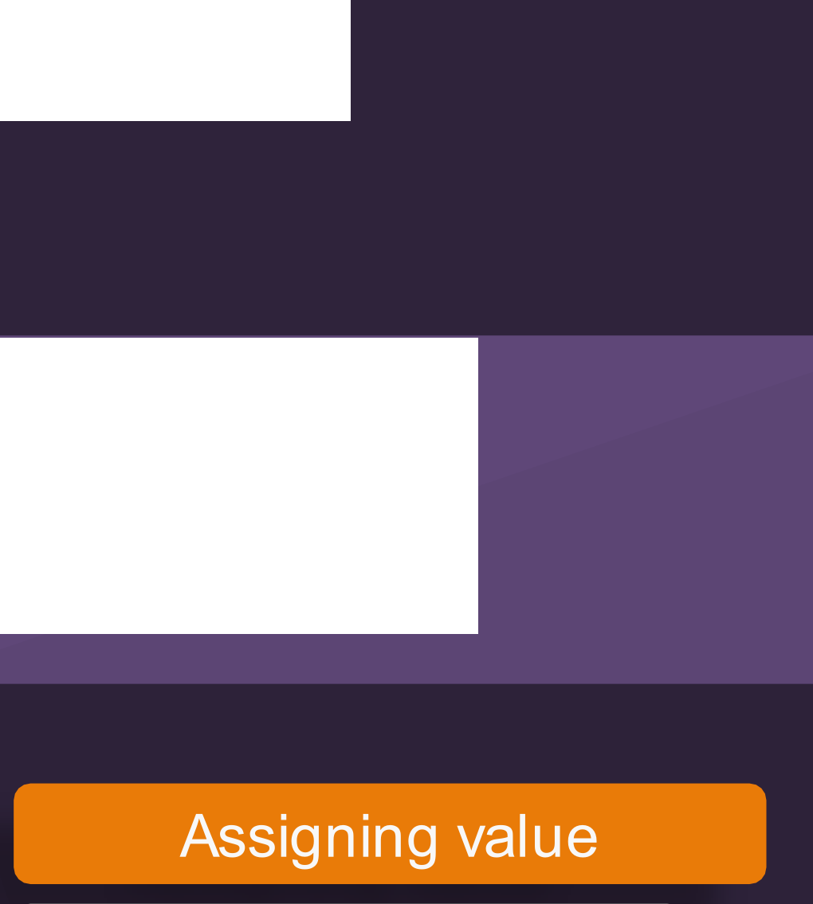
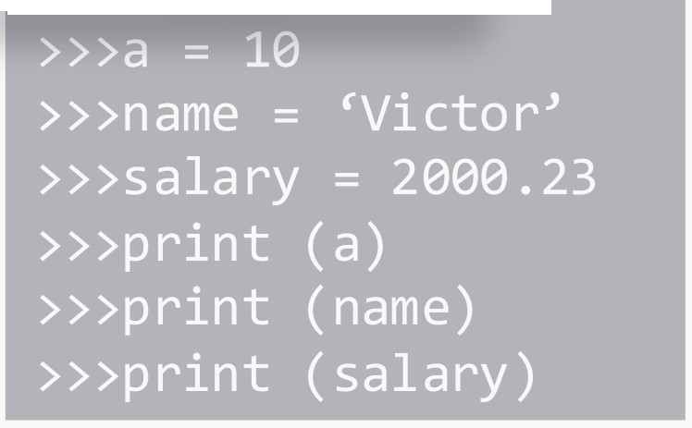
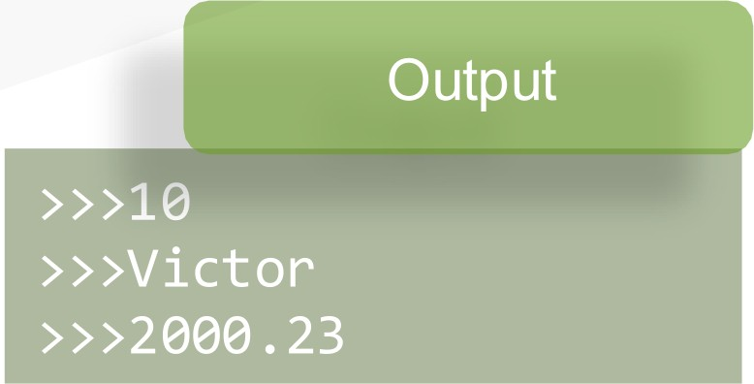

)
Paat
Assigning single value to a variable...
Input
Python: ariable
Multiple assignment
www.inte 11ipa at. com

Slide 10


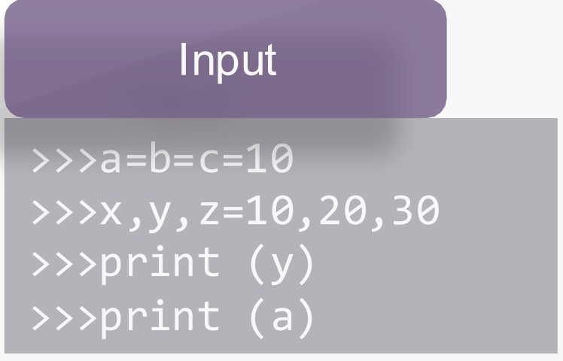
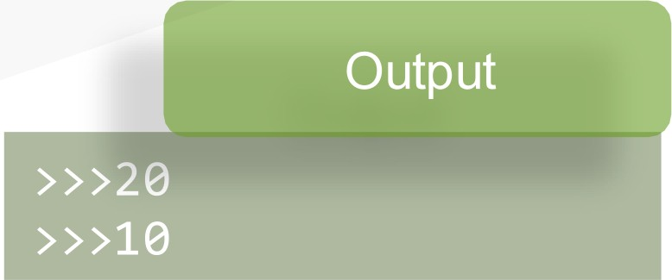
)
Paat
Python:
ariable
Assigning value
www.inte 11ipa at. com

Slide 11
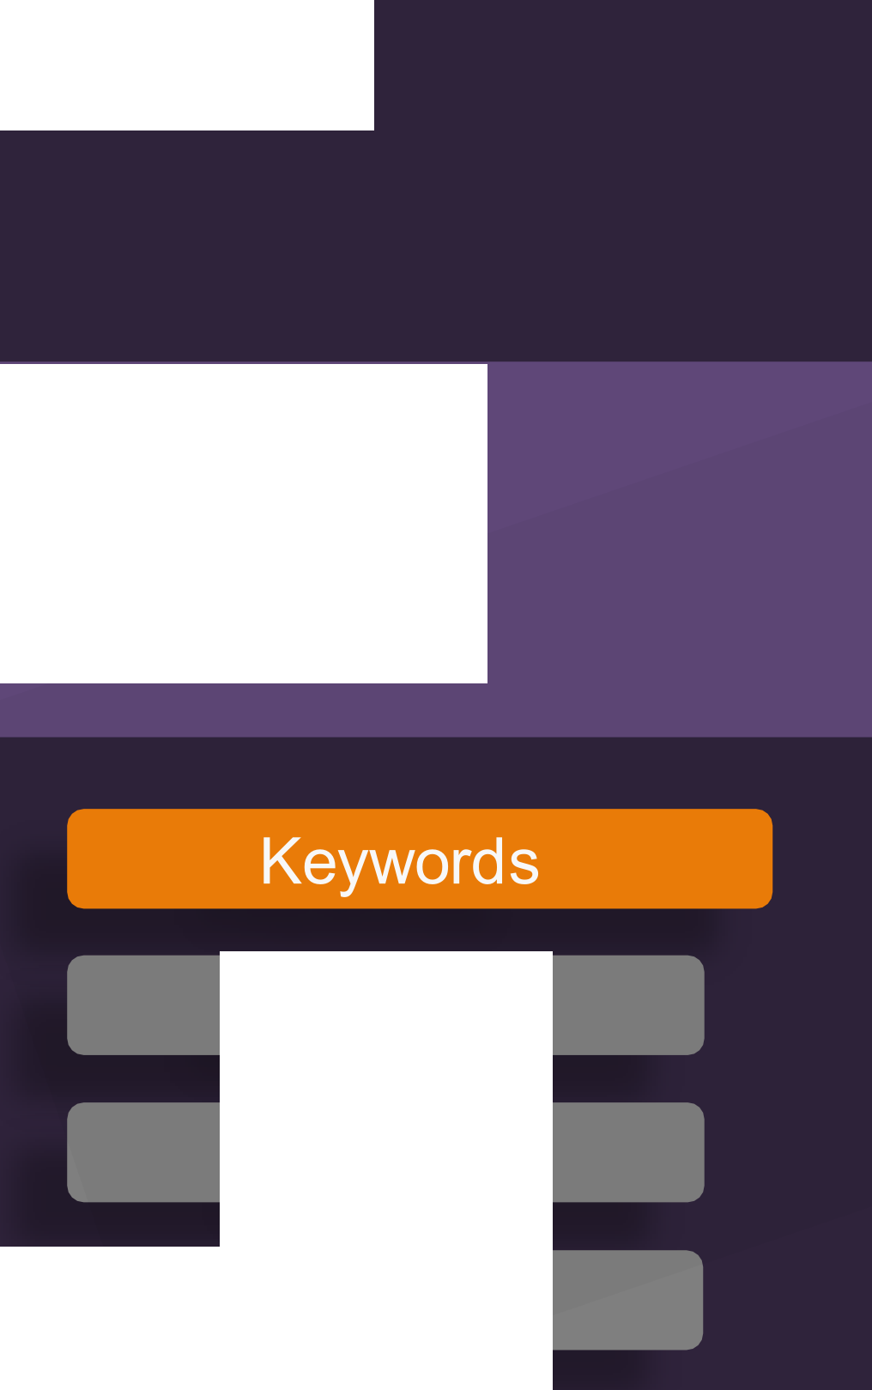

A Paat
What are Keywords?
Python Keywords are special reserved words Convey a special meaning to the compiler/interpreter Each keyword have a special meaning and a specific operation
NEVER use it as a variable
•
•
•
Python:
Tokens
•
True | False | None | and | as
asset | def | class | continue | break
else | finally | elif | del | except
global | for | if | from | import
raise | try | or | return | pass
nonlocal | in | not | is | lambda
Identifiers
Literals
Operators
www.inte11ipaat.com

Slide 12

)
Paat
What are Identifiers?
Identifiers are the name used to identify a variable, function, class or an object
RULES defined for naming an Identifiers:
Python:
Tokens
No special character except underscore (_)can be used as an identifier
Keyword should not be used as an identifier name
Python is case sensitive, i.e Var and var are two different identifier
First character of an identifier can be character, underscore ( _ ) but not digit
Keywords
Literals
Operators
www.inte11ipaat.com

Slide 13

J Paat
Literals: Constant used in Python...
Python:
String Literals
Tokens
Numeric Literals
Boolean Literals
Keywords
Special Literals
Identifiers
Operators
www.inte11ipaat.com

Slide 14
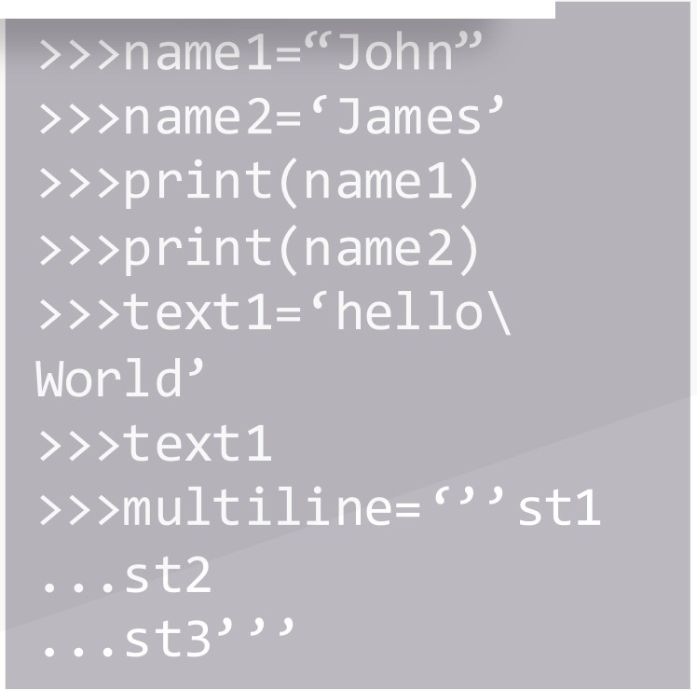
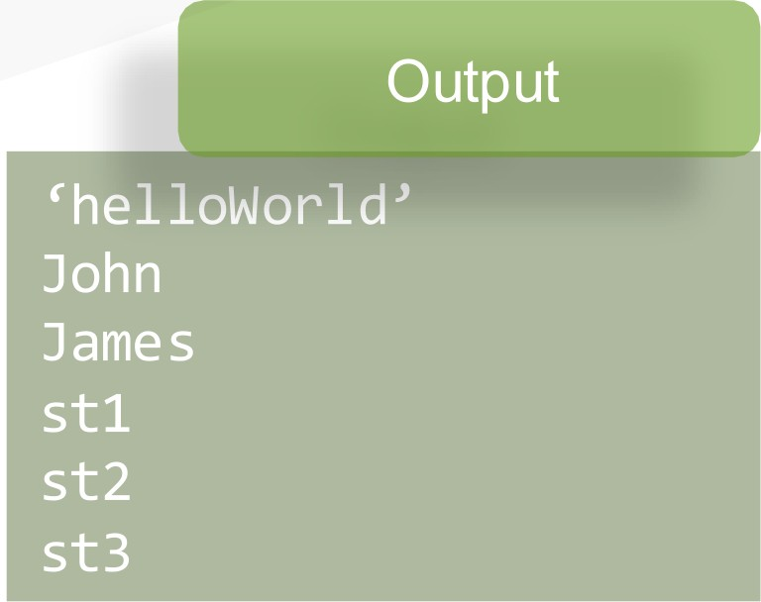
)
Paat
What are String Literals?
Formed by enclosing a text in the quotes Both single and double quotes can be used
•
•
Literals i
n
Input
Python
String Literals
Numeric Literals
Boolean Literals
Special Literals
www.inte11ipaat.com

Slide 15









What are Numeric Literals?
Int
Long
Float
Complex
Literals in Python
+ve and –ve numbers(integers
) with no
fractional part. Ex: 100,-234
Unlimited integer size followed by upper or lowercase L.
Ex: 233424243L
Real numbers with both integer and fractional part
Ex: -213.3
In the form of a+bj. ‘a’ forms the real part & b forms the imaginary part.
Ex: 3.14j
In Python, value of an integer is not restricted by the number of bits and can expand to the limit of the available memory
No special arrangement is required for storing large numbers
String Literals
Numeric Literals Boolean Literals Special Literals
▪
▪
www.intellipaat.com

Slide 16




What are Boolean Literals?
Can have only two values:
Literals in Python
▪
▪
True False
String Literals
Numeric Literals Boolean Literals Special Literals
www.intellipaat.com

Slide 17




What are Special Literals?
Python has one special literal: None
Used to specify to the field that is not created
Literals in Python
Example
>>> val1=10
>>> val2=None
>>> val1 10
>>>
>>>
None
>>>
String Literals
Numeric Literals Boolean Literals Special Literals
val2
print(val2)
www.intellipaat.com

Slide 18






















Types of Operators…
Arithmetic Operator
Operators in Python
Assignment Operator
Comparison Operator
Logical Operator
Keywords
Bitwise Operator
Identifiers
Identity Operator
Literals
Membership Operator
Operators
www.intellipaat.com

Slide 19




Operators in Python
Takes two operand to perform
operations on them
Operators
Arithmetic Operator Assignment Operator Comparison Operator
Logical Operator Bitwise Operator Identity Operator
+, -, *, /, %
Example
>>>1+2
3
>>>1-2
-1
>>>2%1
0
Membership Operator
www.intellipaat.com

Slide 20
Assign a value to a variable
Operators in Python
Operators
Arithmetic Operator Assignment Operator
Comparison Operator Logical Operator Bitwise Operator
=,+=, -=, *=
Example
>>>a=10
>>>a*=10 #a=10*10
>>>print(a) 100
Identity Operator
Membership Operator
www.intellipaat.com

Slide 21
Operators in Python
Compare two values and returns true or
false as output
Operators
Arithmetic Operator Assignment Operator Comparison Operator
Logical Operator
Bitwise Operator
=,+=, -=, *=
Example
>>>a=10
>>>a*=10 #a=10*10
>>>print(a) 100
Identity Operator
Membership Operator
www.intellipaat.com

Slide 22
Operators in Python
Used to compare two values and returns
true or false as output
Operators
Arithmetic Operator Assignment Operator Comparison Operator
Logical Operator
Bitwise Operator
and, or , not
Example
>>> a=10<10 and 2>-1
>>> print(a) False
Identity Operator
Membership Operator
www.intellipaat.com

Slide 23




Used to perform bitwise calculation
Operators in Python
Operators
Arithmetic Operator Assignment Operator Comparison Operator Logical Operator
Bitwise Operator Identity Operator
&,|,>>,<<,~
Example
>>>7 | 5
7
>>>7&5 5
How it is calculated?
111 7
101 5
111
7
Membership Operator
www.intellipaat.com

Slide 24
Operators in Python
Test if the two operands share an
identity
Operators
Arithmetic Operator Assignment Operator Comparison Operator Logical Operator Bitwise Operator
Identity Operator
Membership Operator
is, is not
Example
>>>x = 10
>>>x is 10 True
>>>x = 10
>>>x is not 10 False
www.intellipaat.com

Slide 25
Operators in Python
Test whether a value is a member of a
sequence
Operators
Arithmetic Operator Assignment Operator Comparison Operator Logical Operator Bitwise Operator Identity Operator
Membership Operator
in, not in
Example
>>>pets=[‘dog’,’cat’,’wolf’]
>>>‘lion’ in pets
False
>>>‘wolf’ in pets
True
>>>‘me’ in ‘appointment’
True
www.intellipaat.com

Slide 26


Python: Datatype
Datatype
Immutable
Mutable
Strings
Dictionaries
Numbers
Tuples
Lists
Sets
www.intellipaat.com

Slide 27


Datatypes in Python
Example
message = “Hello World"
num = 1234
rate = 13.6
print(type(message)) #return a string print(type(n)) #return an integer print(type(pi)) #return a float
Numbers
Strings
Tuples
Lists
Dictionaries
Sets
www.intellipaat.com

Slide 28
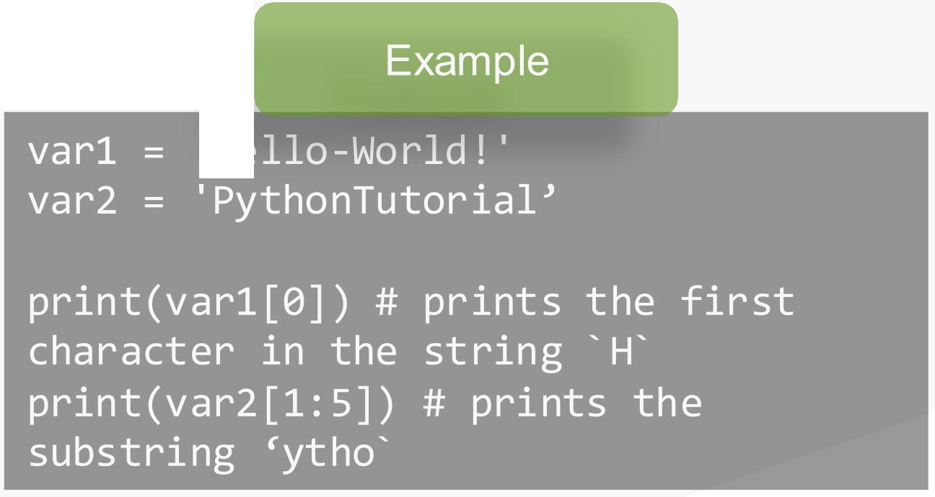



i Paat
Datatypes i
n
Python
'
' He l l o-Wor l d !
Numbers
Strings
Tuples
Lists
Dictionaries
www.inte11ipaat.com

Slide 29








Datatypes in Python
find()
replace()
Numbers
Strings
Tuples
split()
Lists
Dictionaries
count()
Sets
www.intellipaat.com

Slide 30








Tuples are a group of values within ()
Datatypes in Python
Example
>>>myGroup = (‘a’, ‘b', ‘c', ‘d’)
repetation
Numbers
Strings
indexing
Tuples
Lists
slicing
Dictionaries
Sets
www.intellipaat.com

Slide 31












Tuples are a group of values within []
Datatypes in Python
Example
>>>myGroup = (‘a’, 10, 7.12, ‘data’)
concatenation
repetation
Numbers
Strings
Tuples
slicing
extend
Lists
Dictionaries
Sets
insert
www.intellipaat.com

Slide 32









Tuples are a group of values within ()
Datatypes in Python
Example
myDict = { 1: ‘John’ , 2: ‘Bob’, 3: ‘Alice’ }
Key
Numbers
Value
Strings
empty dictionary
Tuples
Integer keys
Lists
mixed keys
Dictionaries
paring
accessing dictionary
Sets
www.intellipaat.com

Slide 33









Unordered collection of items within {}
Datatypes in Python
Example
mySet = {1, 2, 3}
Creating Sets
Numbers
Union
Strings
Tuples
intersection
Lists
difference
Dictionaries
Sets
www.intellipaat.com

Slide 34




Q.1
What would be the output of the following code?
Python: Test
Fill the missing code
test1 = 'PythonProgramming’ print(test1[2:6])
Yourself
Note: Post your answer in the comment section below
www.intellipaat.com

Slide 35


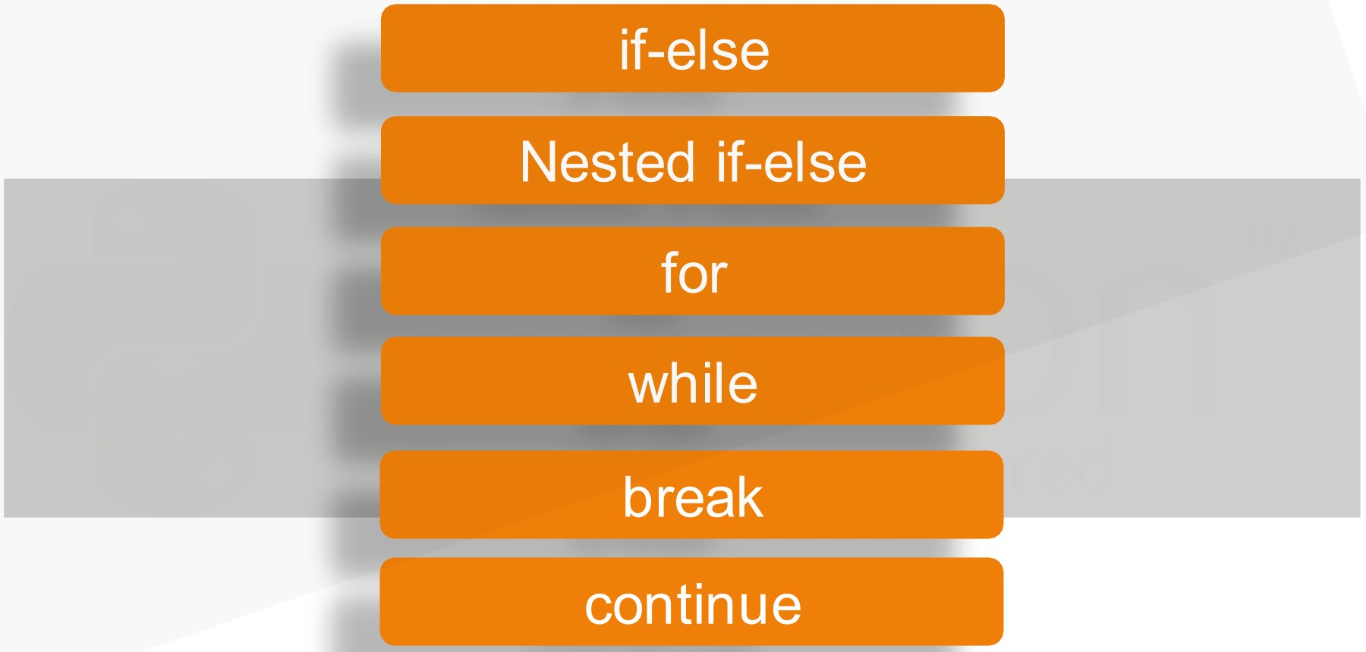

_JnteIiiPaat
Defines the flow of the execution of program...
Python: Flow Control
..₋.,. •
·
1
-- -
.
www.inte11ipaat.com

Slide 36
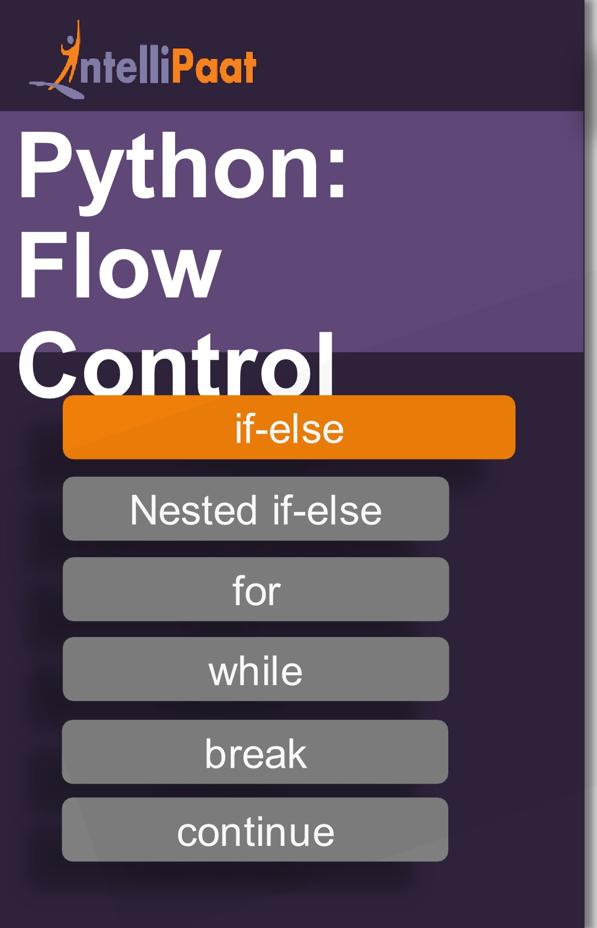

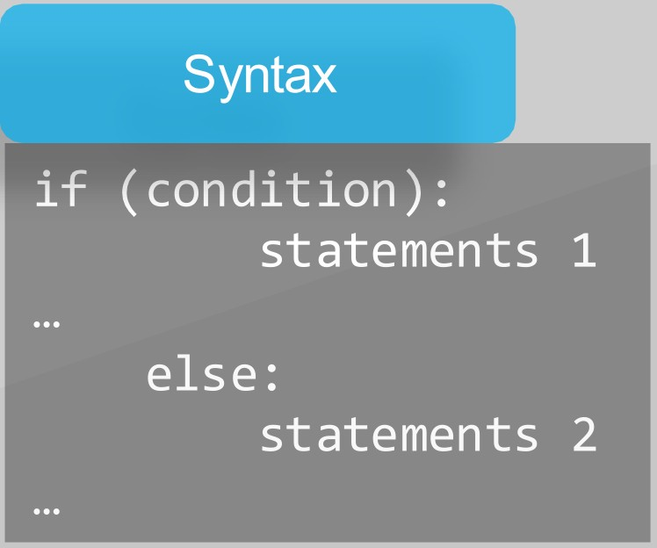
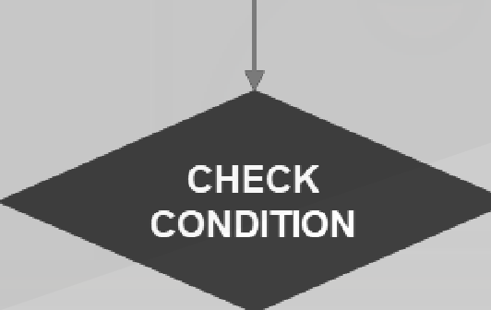
START
FALSE
TRUE
EXECUTE BLOCK 2
1
EXECUTE BLOCK
www.inte11ipaat.com

Slide 37
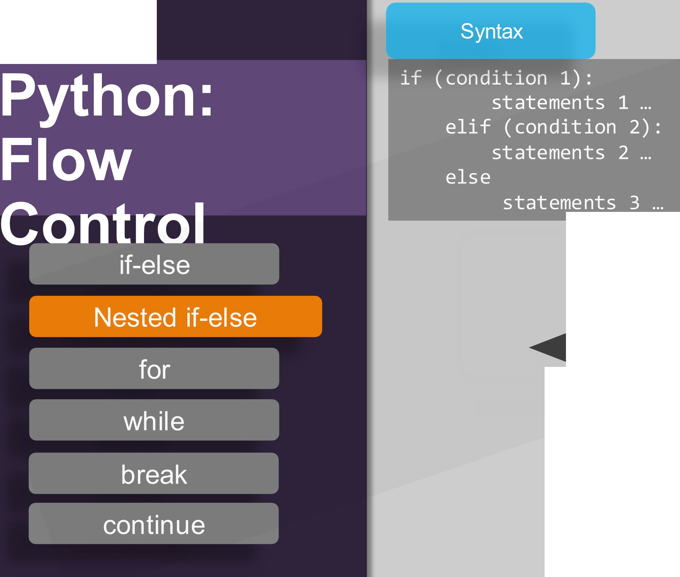


J nte lliPaat
START
FALSE
CHECK
CONDITION 1
FALSE
TRUE
CHECK
CONDITION 1
EXECUTE BLOCK 1
TRUE
EXECUTE BLOCK 3
EXECUTE BLOCK 2
www.inte11ipaat.com

Slide 38
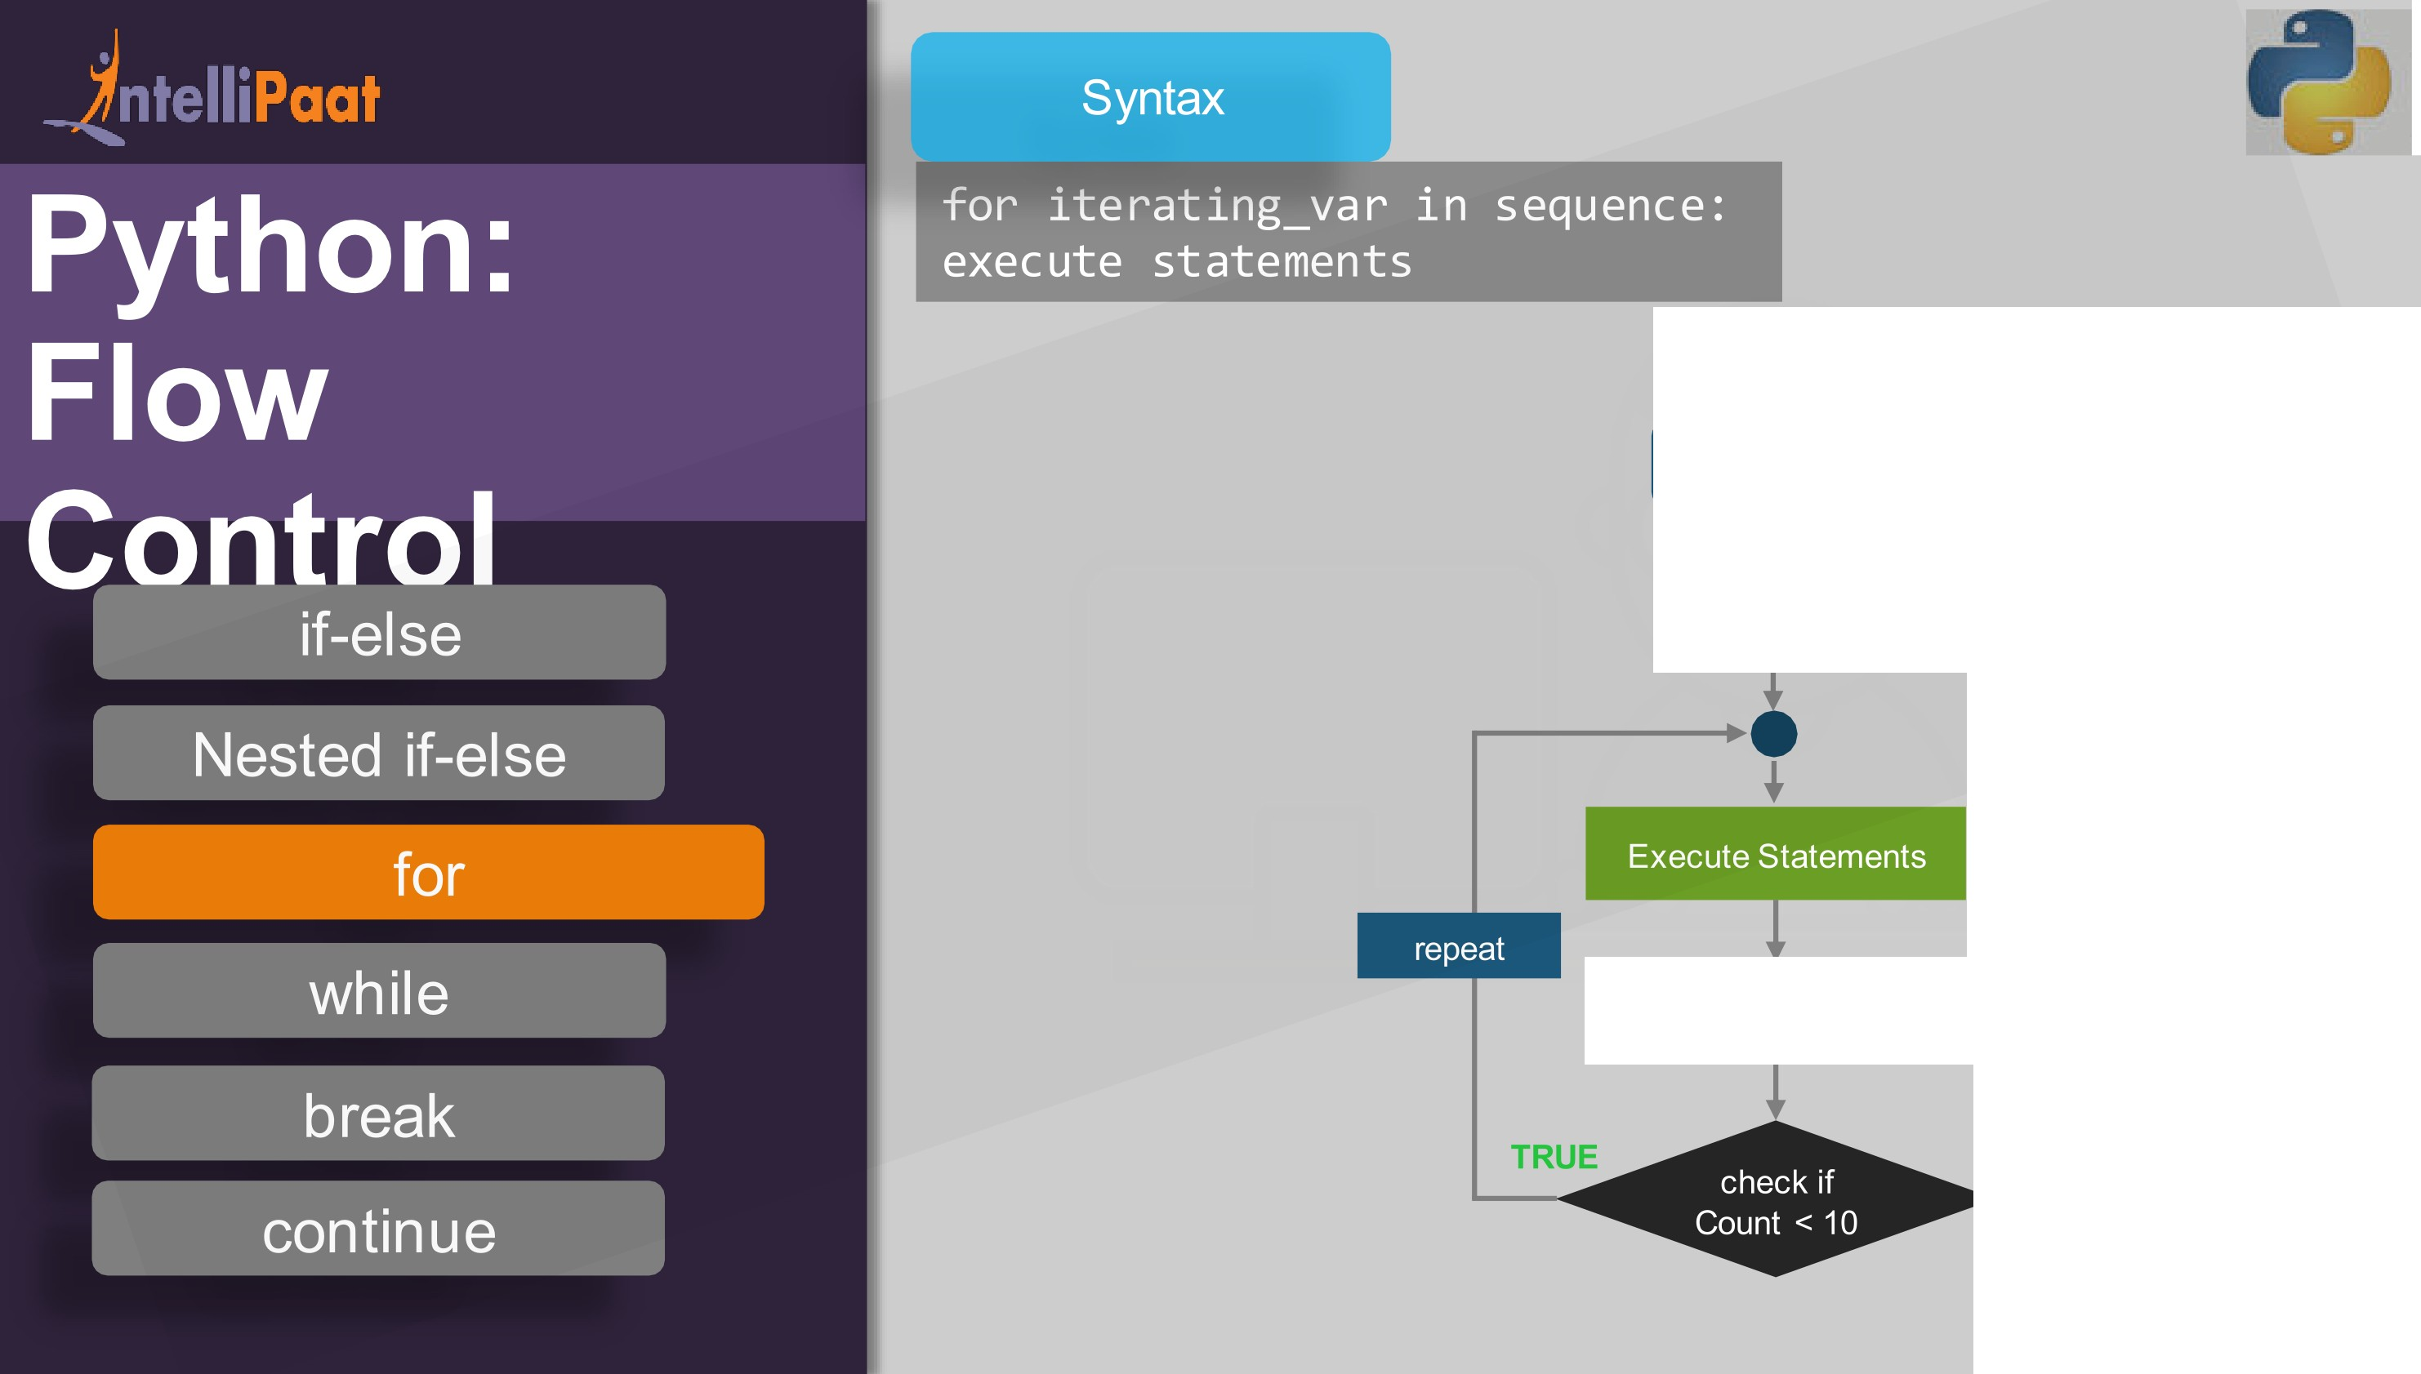

START
Count = 0
Add 1 to Count
FALSE
www.inte11ipaat.com

Slide 39
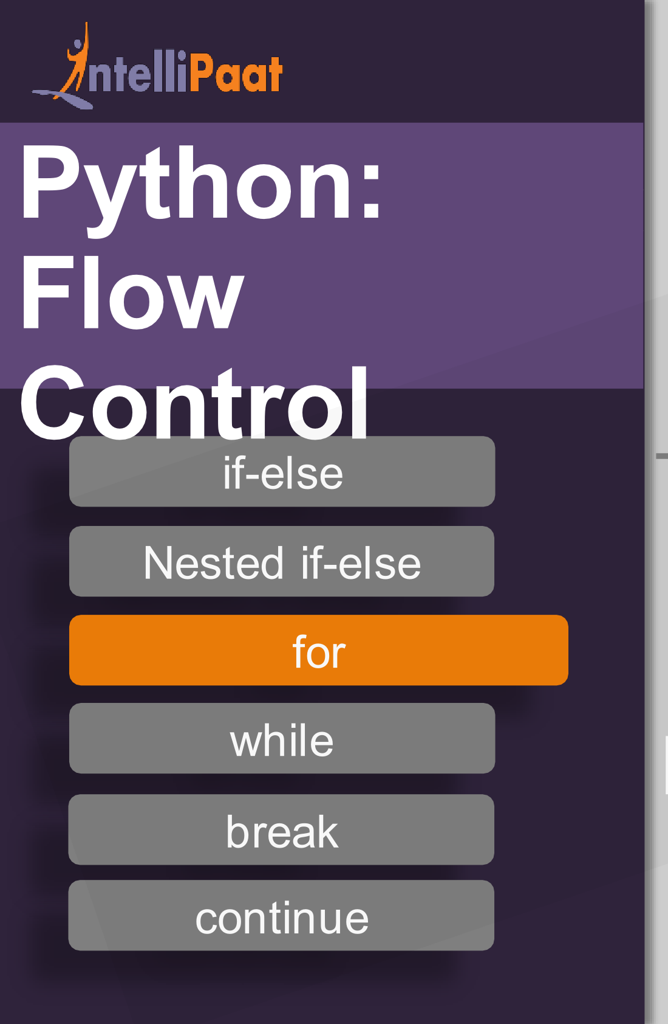
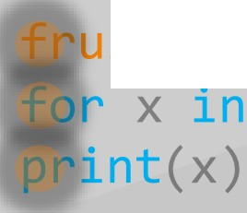
,.
code
output
1 '
2
3
its = ["apple", "banana", "cherry"] fruits:
apple banana cheery
variable
x in fruit[0] =
x in fruit[l] =
x in fruit[2] =
apple banana cherry
www.inte11ipaat.com

Slide 40
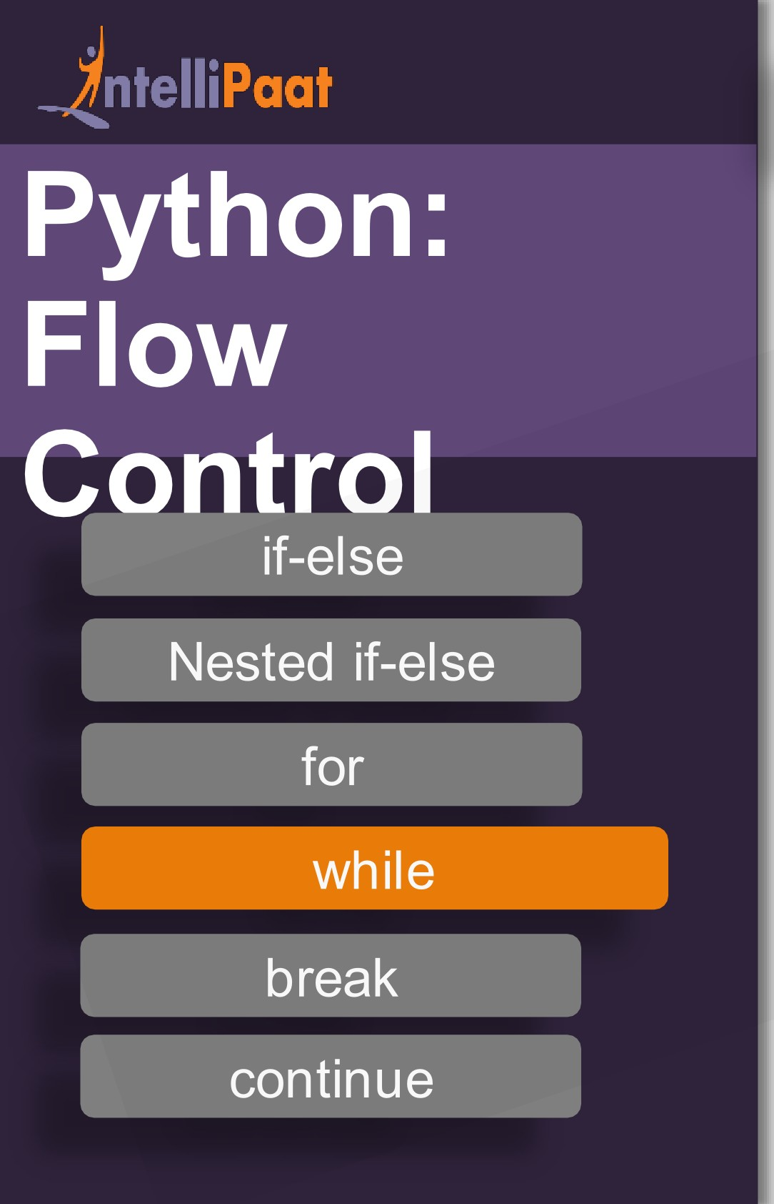
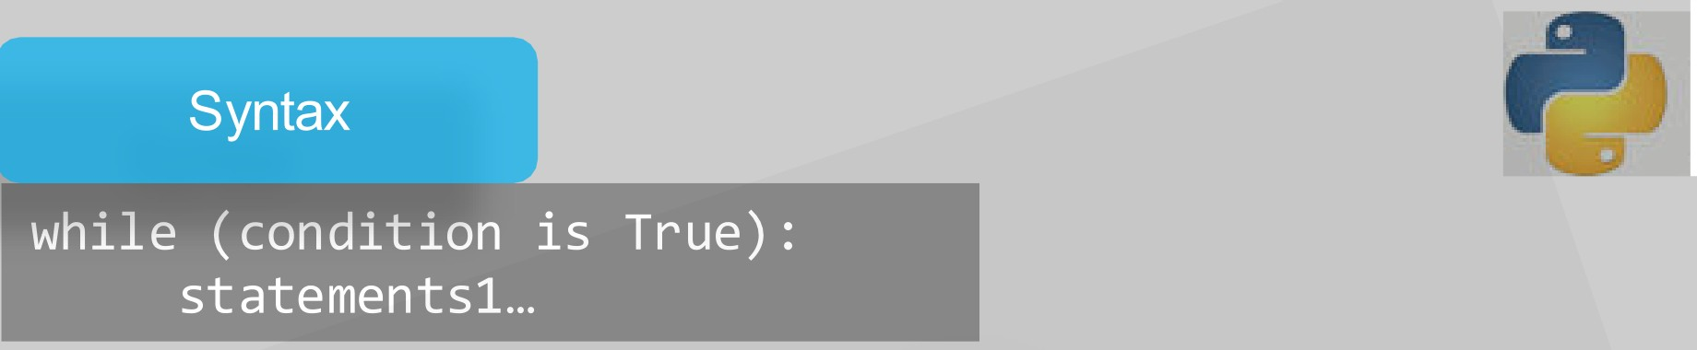
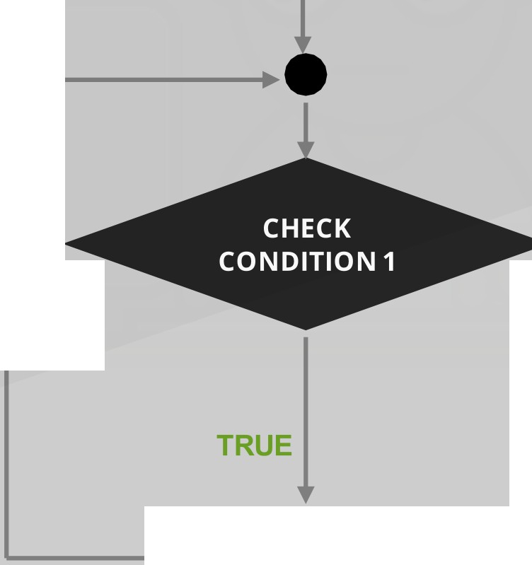
START
FALSE
l
repeat
EXIT LOOP
1
EXECUTE BLOCK
www.inte11ipaat.com

Slide 41
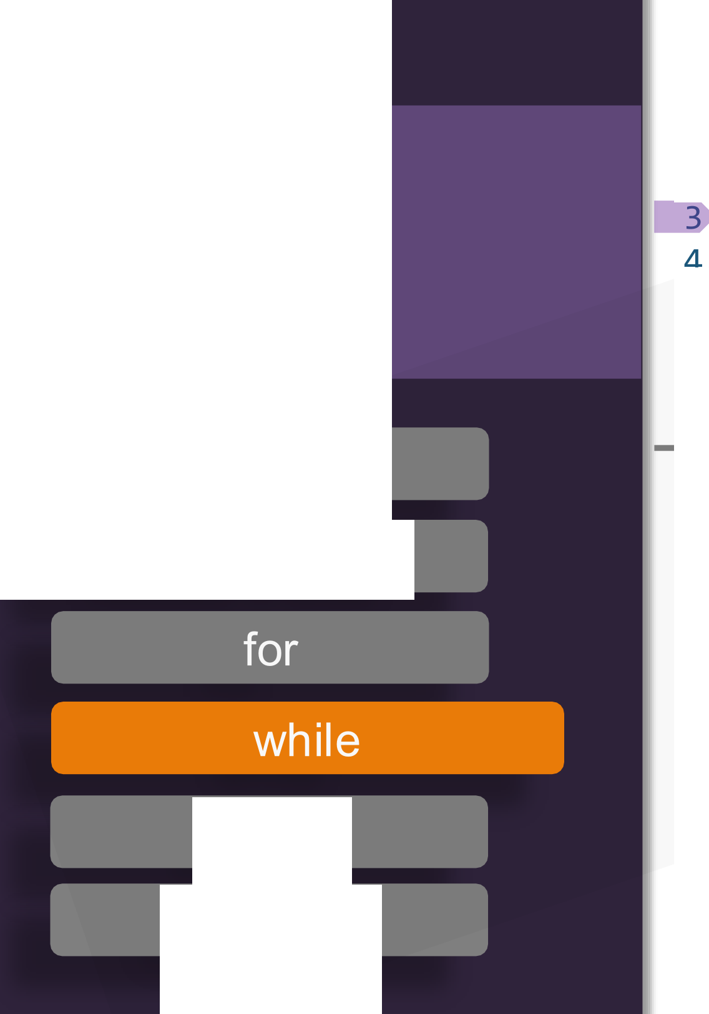
J Paat
code
output
Python
:
1 a = 1
while a<S : prin t( a) a+=2
1
3
-
Flow
Control
if-else
variable
a = 1
Nested if-else
is less than 5
a = a+2= 1+2= 3
a = 3
is less than 5
is less than 5
a = 5
break
continue
www.inte11ipaat.com

Slide 42
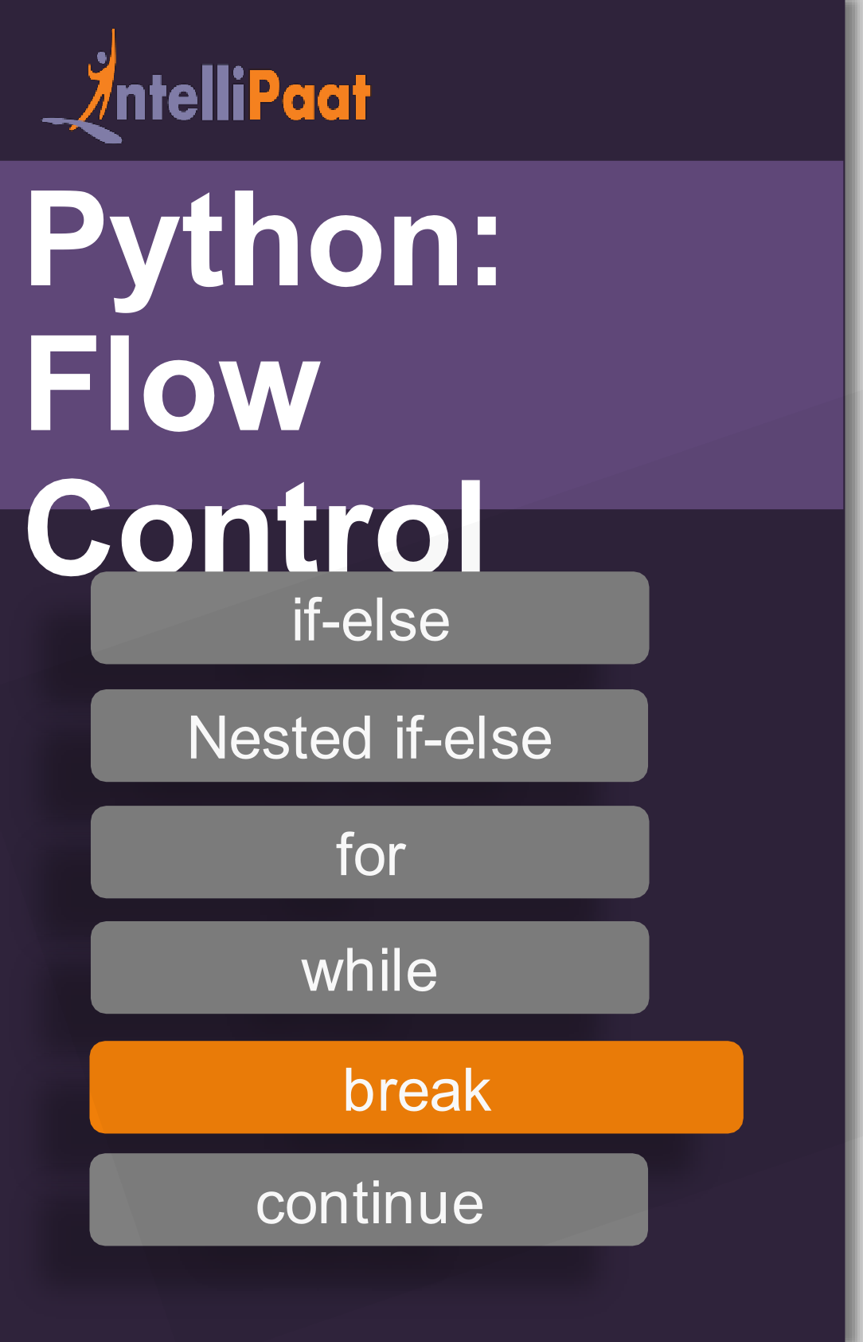
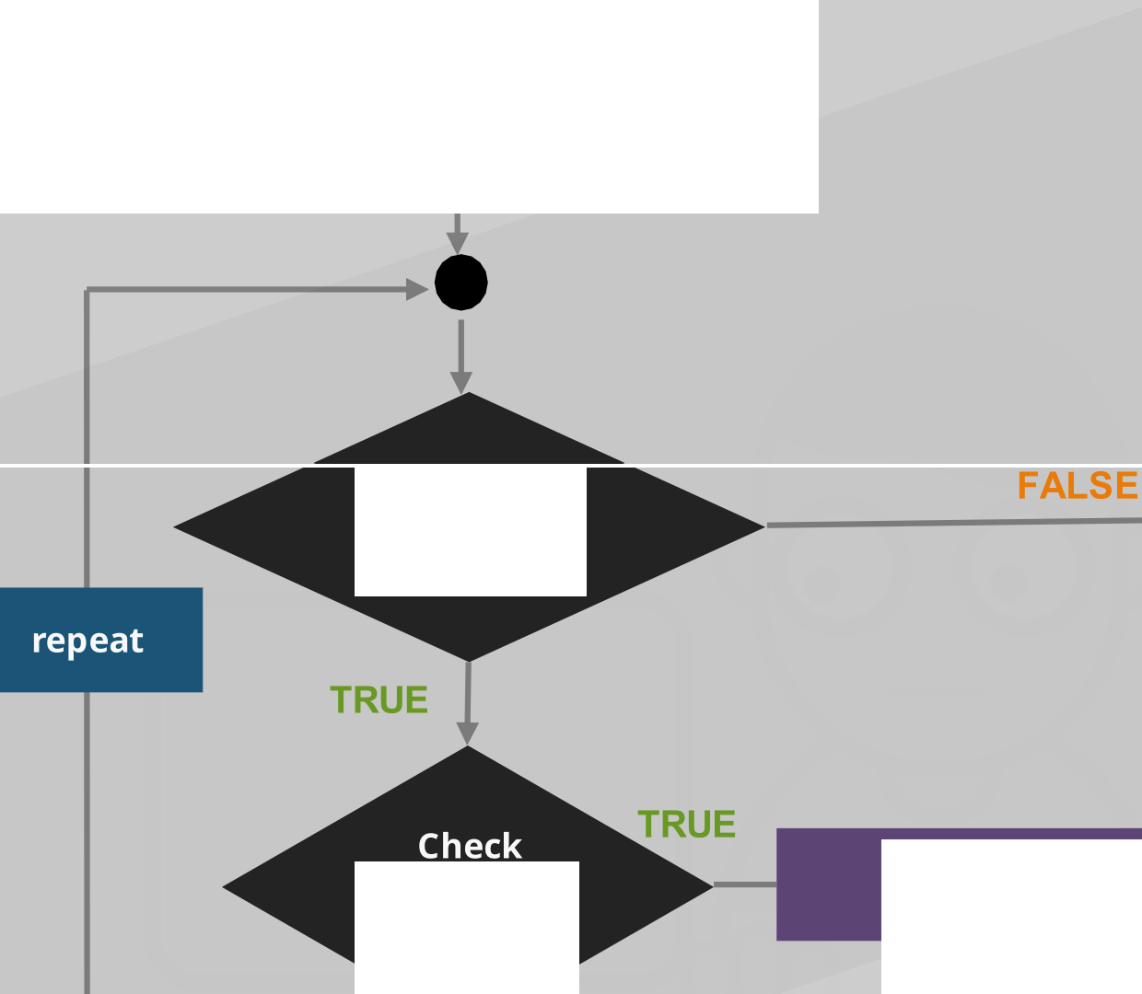

START
CHECK
CONDITION
1
break
break
condition
FALSE
1
EXECUTE BLOCK
www.inte11ipaat.com

Slide 43
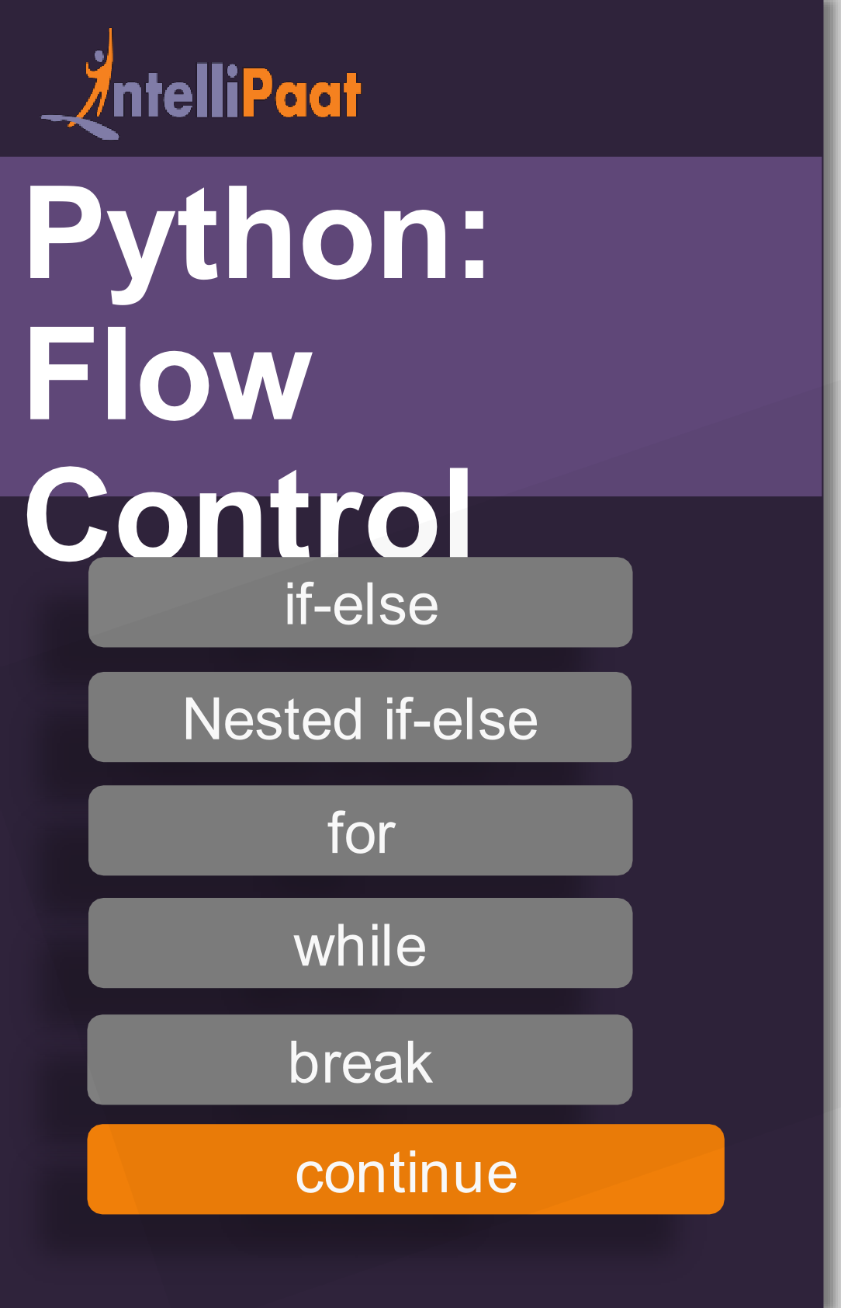
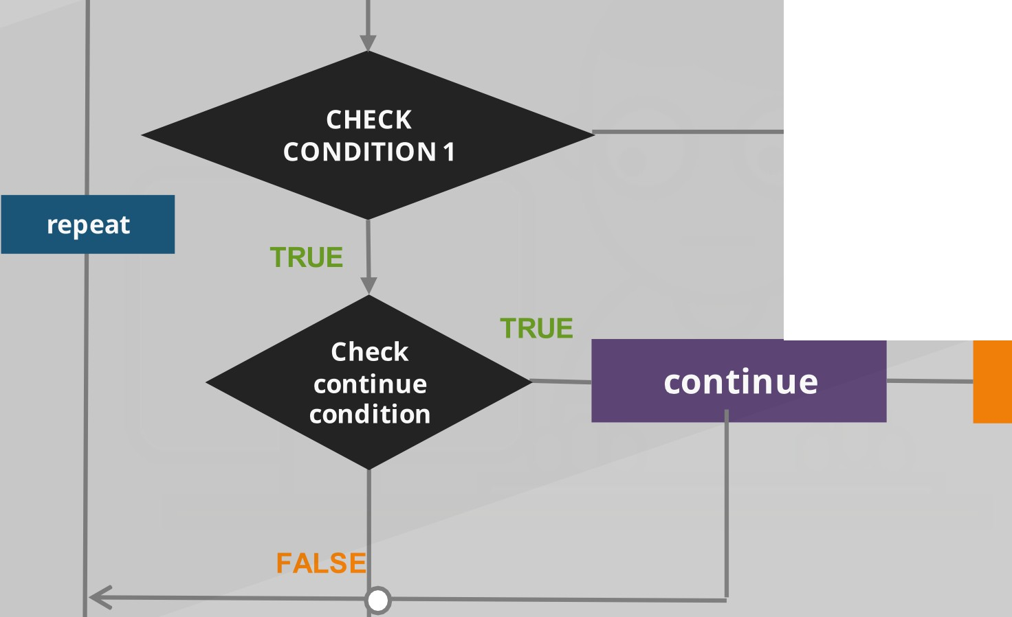

r-- --•
START
FALSE
EXECUTE BLOCK 1
www.inte11ipaat.com

Slide 44


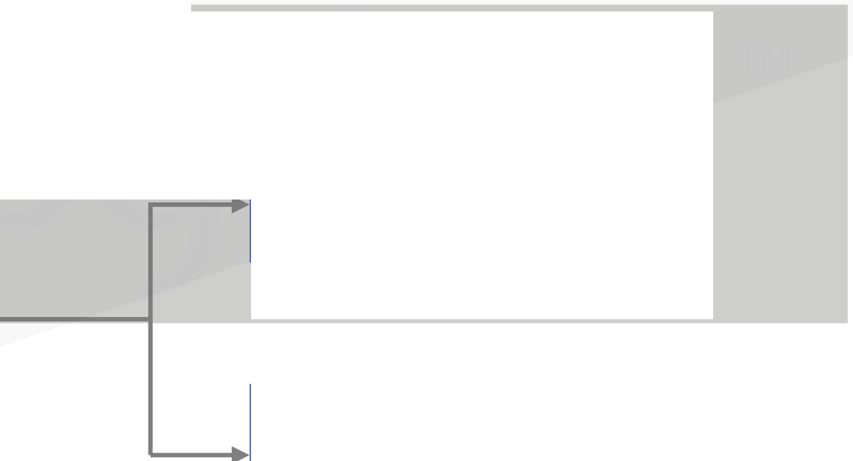
_JnteIiiPaat
What are functions?
A function is a block of organized, reusable sets of instructions that is used to perform some related actions
Python
:
Functio
n
User Defined Function
·₋•·
Function
-- -
...,.
.
Built-in Function
1
www.inte11ipaat.com

Slide 45

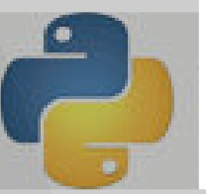
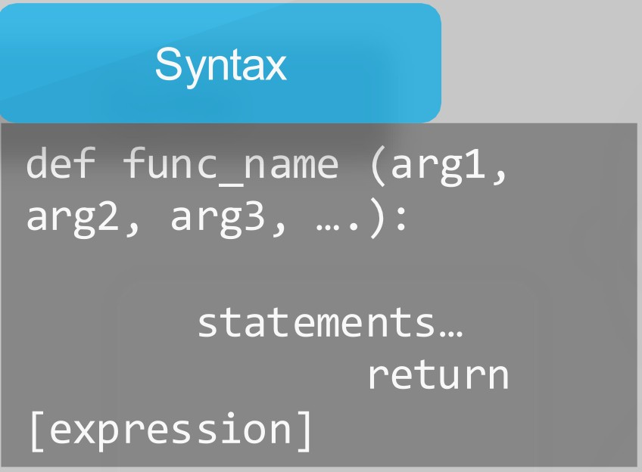
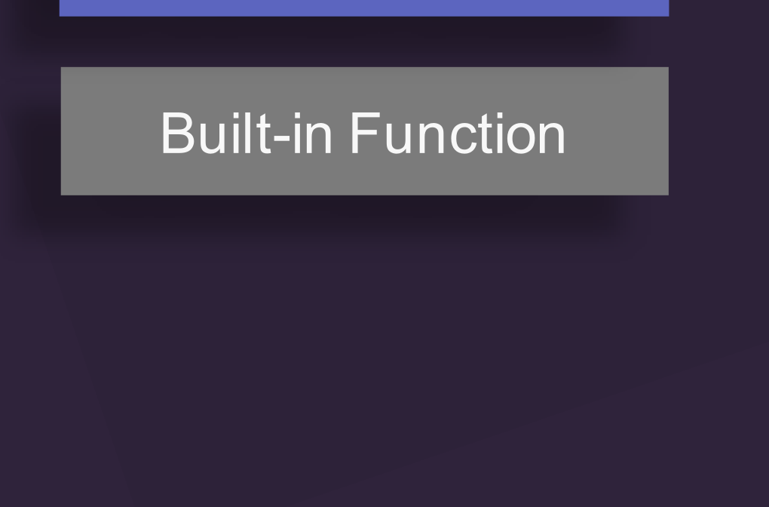
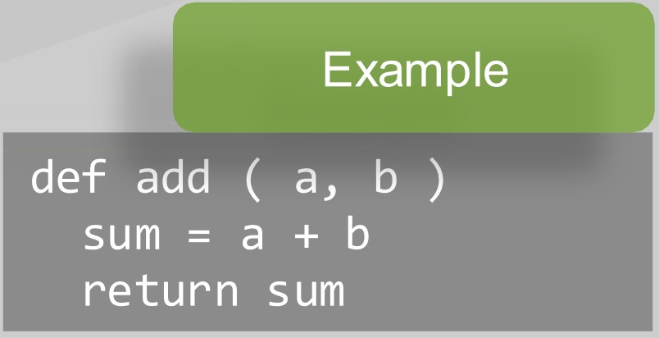
J nte lliPaat
How to define a function?
Python
:
Function
n
User Defined Functio
www.inte11ipaat.com

Slide 46
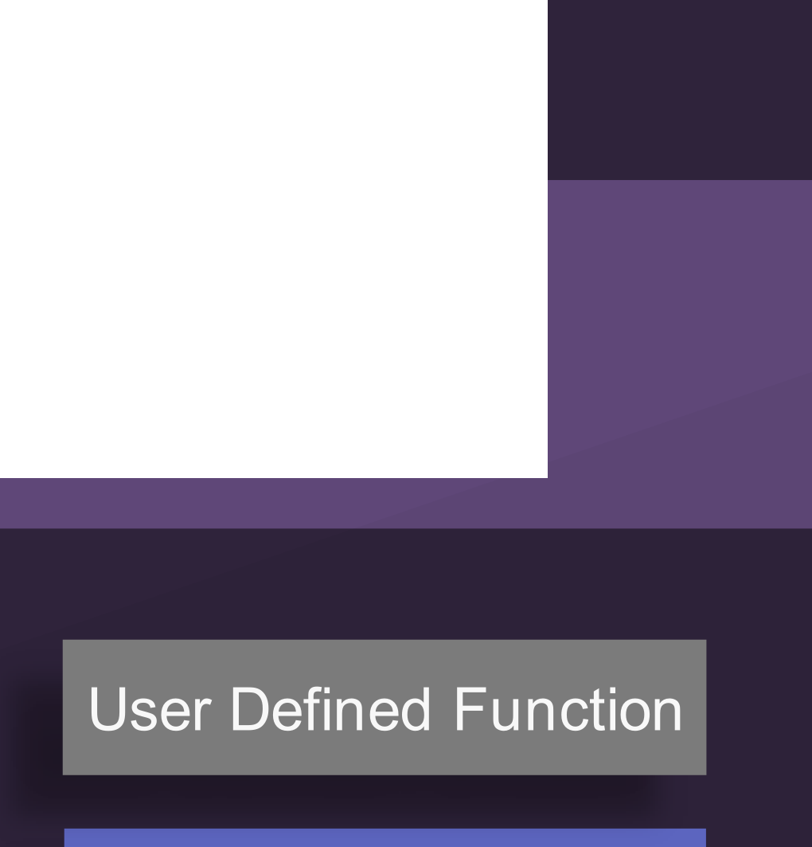

J nte lliPaat
How to define a function?
Python
:
abs(): Returns the absolute value of a number
Functio
n
all(): Returns True if all items in an iterable object are true
any(): Returns True if any item in an iterable object is true
ascii(): Returns a readable version of an object. Replaces non-ascii characters with escape character
n
Built-in Functio
bin(): Returns the binary version of a number
bool(): Returns the Boolean value of the specified object
www.inte11ipaat.com

Slide 47


_JnteIiiPaat
Calling the defined function ...
Python: Function
Pass by Reference
..₋.,. •
·
1
-- -
.
www.inte11ipaat.com

Slide 48
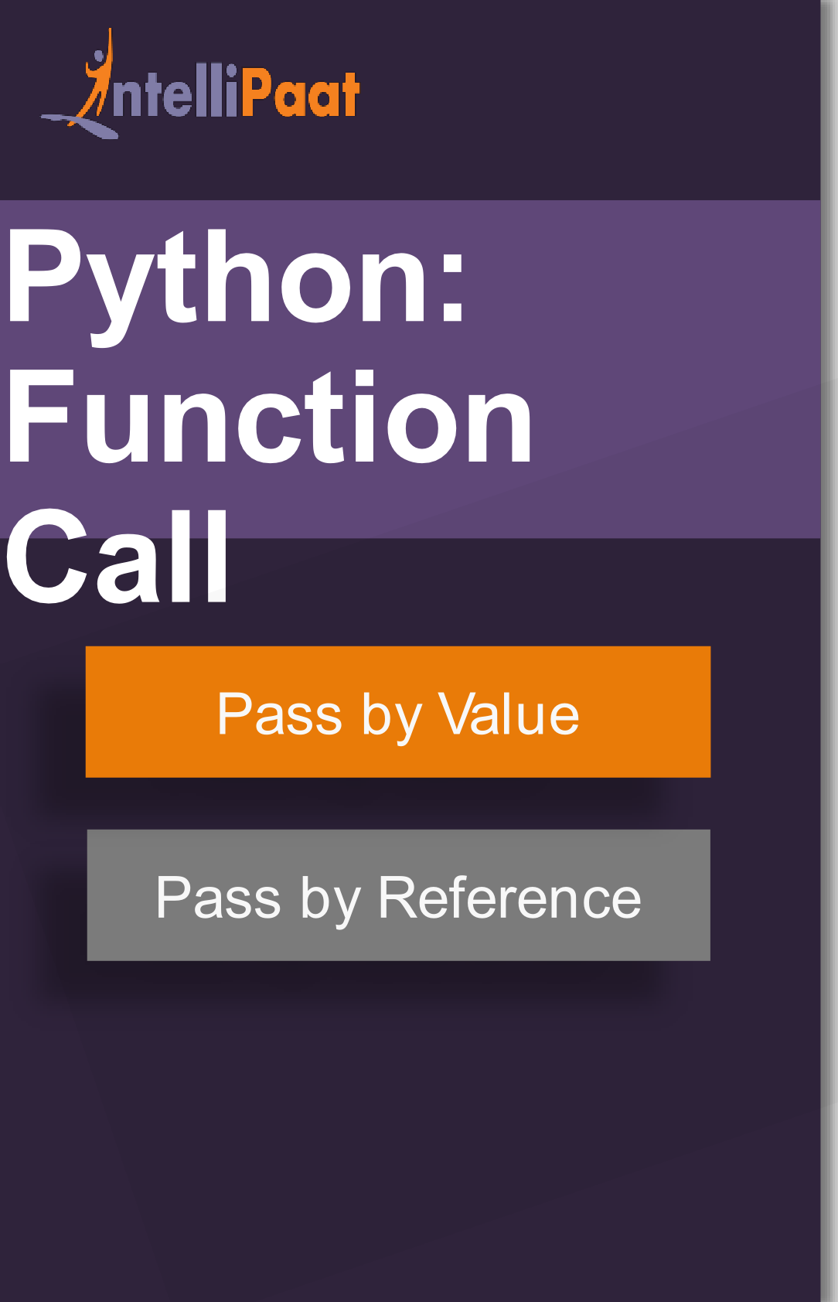
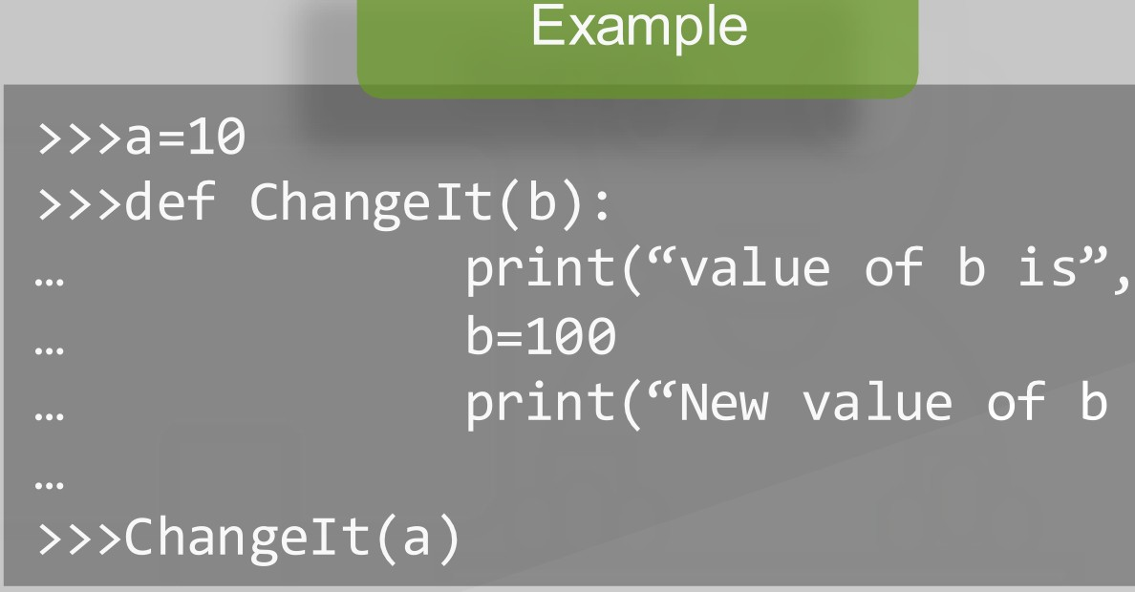
,.
Calling a function by passing the value...
•
•
www.inte11ipaat.com

Slide 49
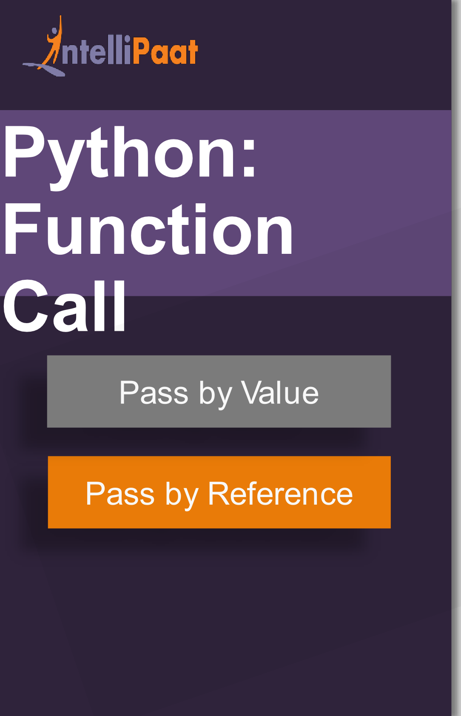
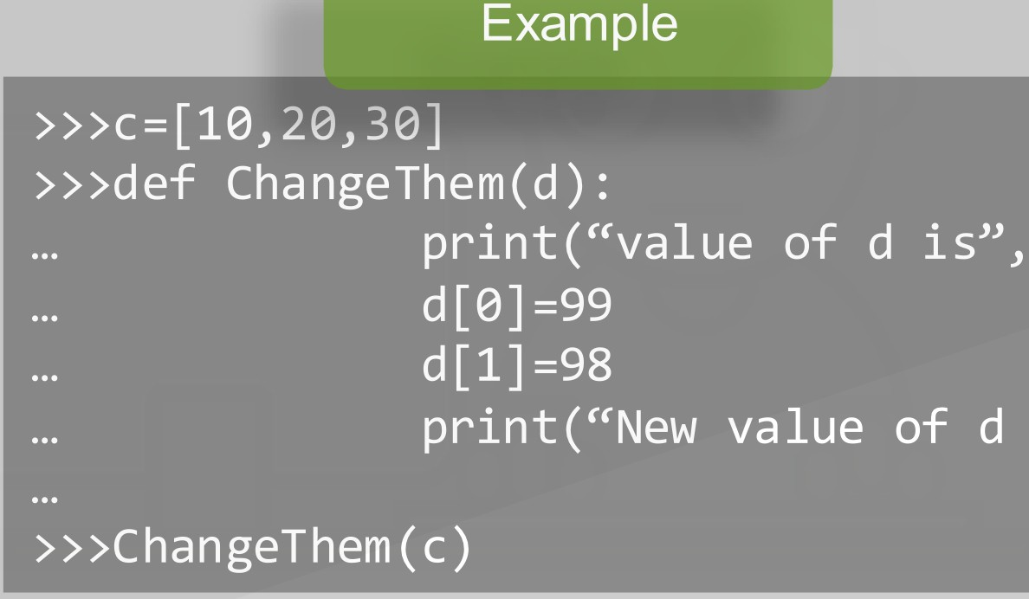
,.
Calling a function by passing the value...
•
•
www.inte11ipaat.com

Slide 50



J Paat
Python: Function Call
pass by reference | pass by value
cup - fillCup( | cup - ) fillCup( | )
Pass by Value
www.intellipaat.com

Slide 51
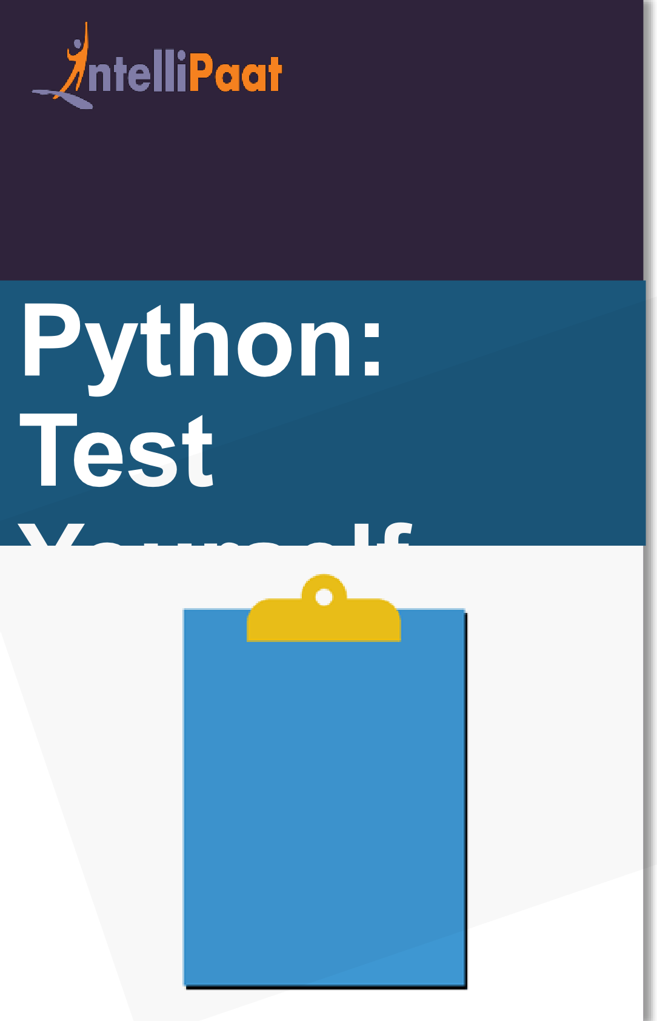
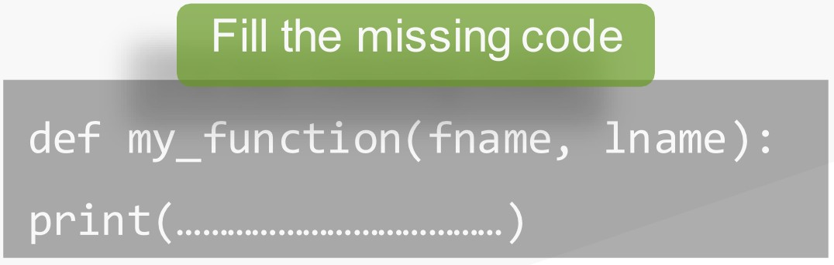

Q■2
Following function takes two parameters and print the first one. Fill the missing code:
Note: Post your answer in the comment section below
www.inte11ipaat.com

Slide 52
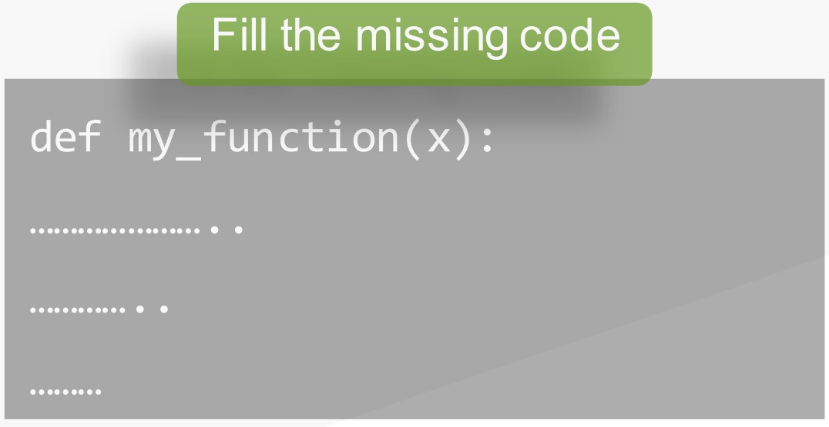
Q 3
A function which return the x parameter + 10.
Fill the missing code:
■
Note: Post your answer in the comment section below
www.inte11ipaat.com

Slide 53

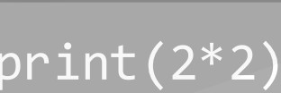
Q■4
What is the output of ..
Output??
fruits
=
("apple",
"banana",
"cherry")
if
"mango"
in
:
fruits
print(3+4)
else
Note: Post your answer in the comment section below
www.inte11ipaat.com

Slide 54

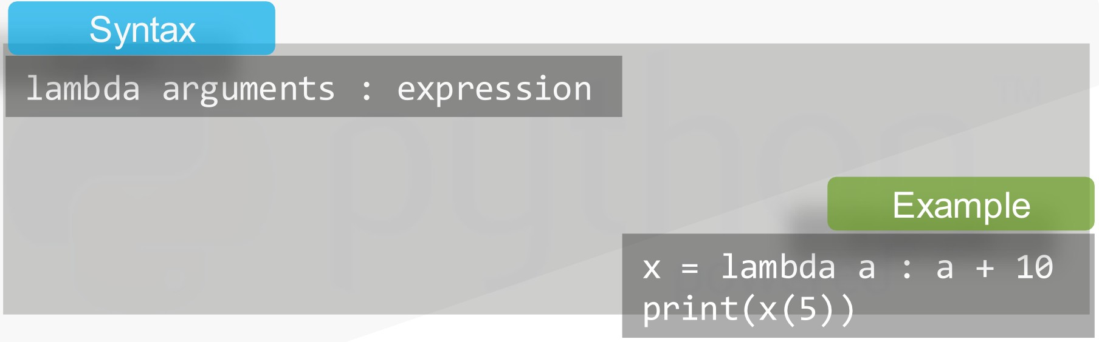

_JnteIiiPaat
What is Lambda Function?
Anonymous function, i.e a function having no name
Python: Lambda
..₋.,. •
·
1
-- -
.
Note: Lambda function cannot contain more than one expression
www.inte11ipaat.com

Slide 55
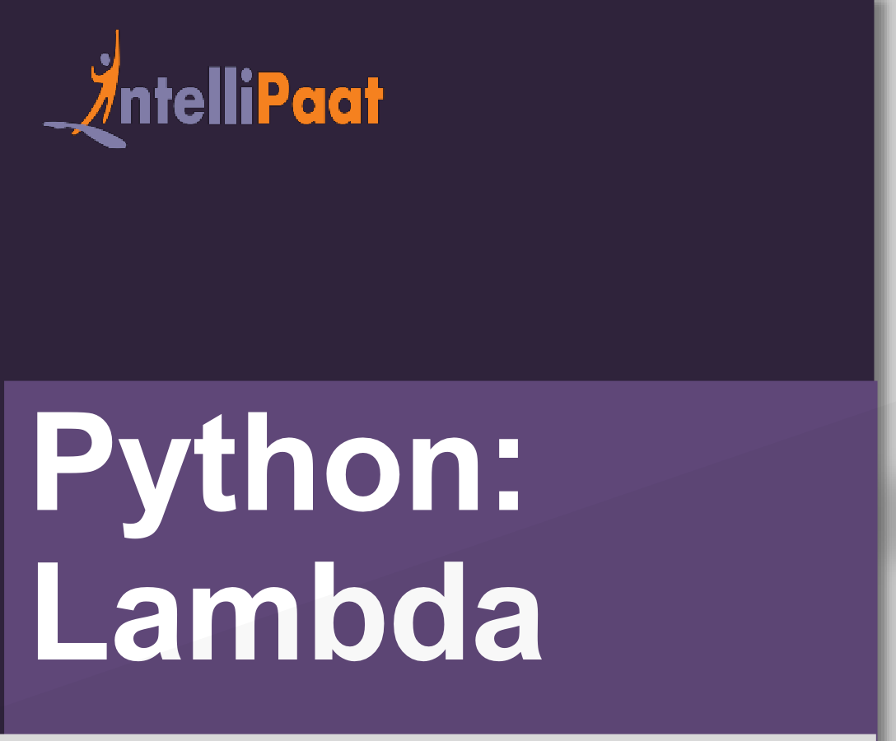
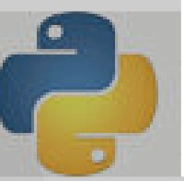
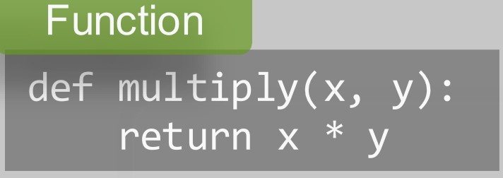

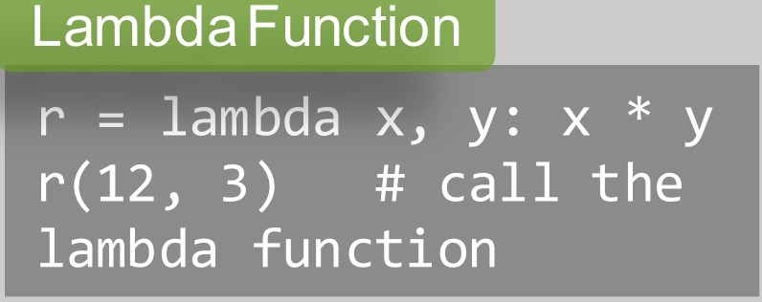
Function vs Lambda Function
www.inte11ipaat.com

Slide 56
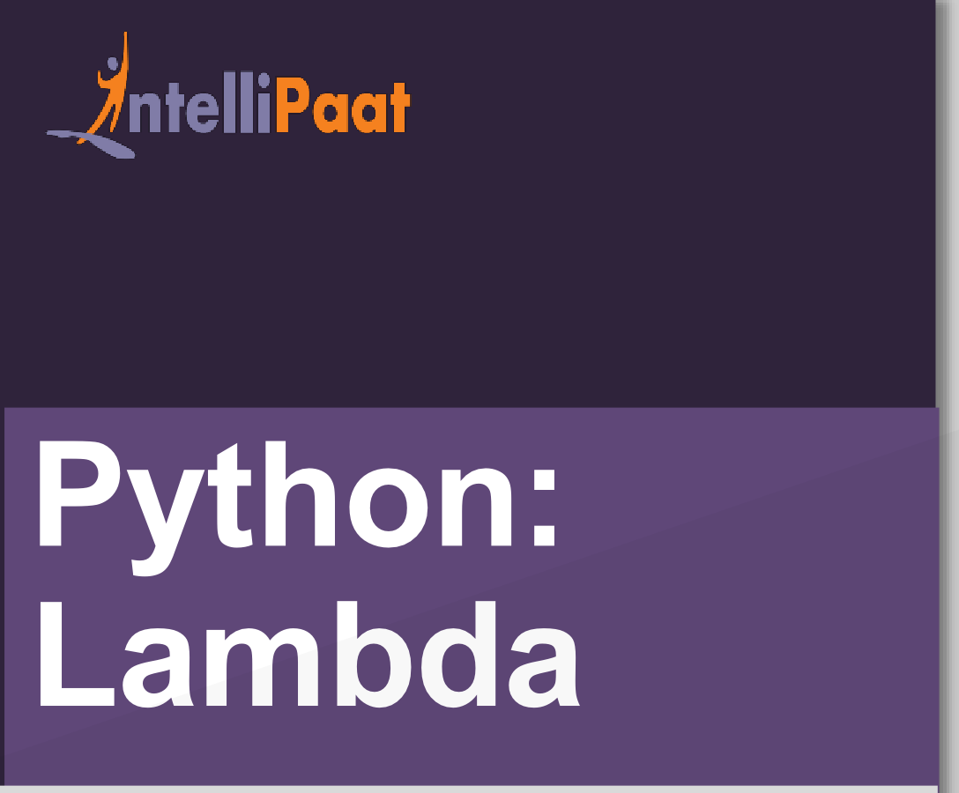

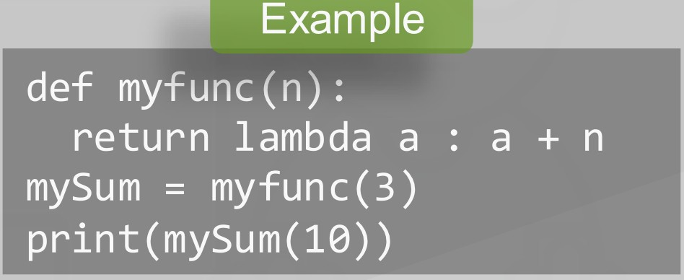
Power of Lambda: Anonymous Function inside another function...
www.inte11ipaat.com

Slide 57
Q.5 Write a lam6cta function mat sums
argument a, b, and c and print the result
Note: Post your answer in the comment section below
www.inte11ipaat.com

Slide 58
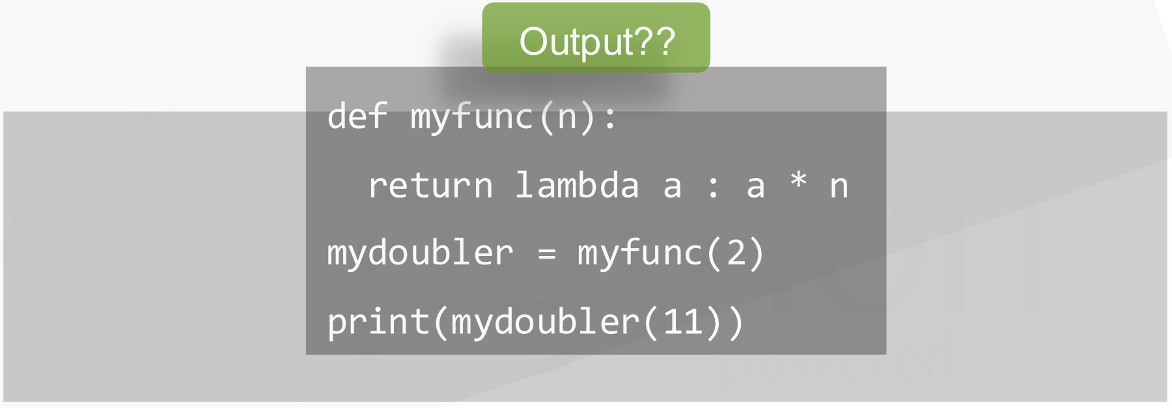
What is the output of ..
Q■6
Note: Post your answer in the comment section below
www.inte11ipaat.com

Slide 59
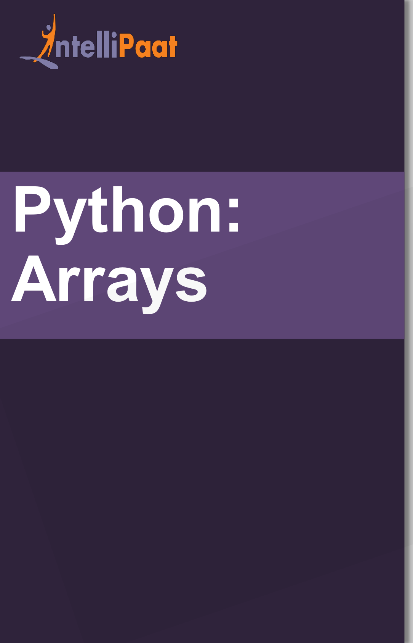




What is an Array?
Used to store multiple values in one single variable.
Note: Python does not have built-in support for Arrays,
but Python lists can be used instead.
www.inte11ipaat.com

Slide 60














Accessing the element
>>>x = cars[0] Ford
Python: Arrays
Adding the element
Modifying the element
>>>cars.append(“Opel")]
>>>print(len(cars)) 4
>>>cars[0] = “Honda”
>>>print(cars[0]) Honda
Removing one element
Length of array
>>>cars.pop(1)
>>>x = len(cars) 3
Removing specific element
Looping the Array
cars.remove("Volvo")
for x in cars: print(x)
www.intellipaat.com

Slide 61

,.
J nte lliPaat
What is a class and an object in Python?
Python is an object-oriented programming language
Almost everything in Python is an object, with its properties and methods
A Class is like a "blueprint" for creating objects
Python
:
Classes/Objec
t
Ooject
obj1J = MY,C1 as s i:2r.init(obj1J.x)
·
www.inte11ipaat.com

Slide 62


,.
J ntelliPaat
The open() function takes two parameters; filename, and mode.
Python: File
JJ nrllinn
Open
www.inte11ipaat.com

Slide 63

J nte lliPaat
"r" - Read - Default value. Opens a file for reading, error if the file does not exist
"a" - Append - Opens a file for appending, creates the file if it does not exist
"w'' - Write - Opens a file for writing, creates the file if it does not exist
"x" - Create - Creates the specified file, returns an error
if the file with same name exists
Python:
File
JJ nrllinn
Open
www.inte11ipaat.com

Slide 64

J nte lliPaat
Python
:
e
Fil
H
" r."
" r."
#readline() is used to return one line
www.inte11ipaat.com

Slide 65



# using readline() twice prints first two line
www.inte11ipaat.com

Slide 66



j ntelliPaat
To write to an existing file, you must add a parameter to the open{) function
Python
:
"a" - Append - will append to the end of the file
"w'' - Write - will overwrite any existing content
e
Fil
Write/Create
www.inte11ipaat.com

Slide 67


J nte lliPaat
Creating a new file...
"x" - Create - Create a file, returns an error if the file exist
"a" -Append - Create a file if the specified file does not exist
"w" - Write - Create a file if the specified file does not exist
Python
:
e
Fil
H
Write/Create
www.inte11ipaat.com

Slide 68


Import OS module to delete a file...
www.inte11ipaat.com

Slide 69
j ntelliPaat
QUIZ
www.inte11ipaat.com

Slide 70





jn telliPaat
Quiz 1
Where did the Python name come from?
Python Snake
Monty Python's Circus Flying
Monty Python's Flying Circus
None of the above
www.inte11ipaat.com

Slide 71




Answer 1
jn telliPaat
1.Where did the Python name come from?
a)Python Snake
a)Monty Python's Circus Flying
a)Monty Python's Flying Circus
a)None of the above
www.inte11ipaat.com

Slide 72




Quiz 2
jn telliPaat
1.Which among the following can be an identifier
in Python?
a)@HEllo
a}lhello
a)$Hello1
a)_Hellol
www.inte11ipaat.com

Slide 73





Answer 2
jn telliPaat
1.Which among the following can be an identifier
in Python?
a)@HEllo
a}lhello
a)$Hello1
a)_Hellol
www.inte11ipaat.com

Slide 74


Quiz 3
jn telliPaat
1.What is the output of the following
 | 2.4 |  | I | 6
a)lO
www.inte11ipaat.com

Slide 75

Answer 3
jn telliPaat
1.What is the output of the following
 | 2.4 |  | I | 6
a)lO
www.inte11ipaat.com

Slide 76



Quiz 4
jn telliPaat
1.What is the output of the following
10<<1
a)10
a)20
a)None of the above
www.inte11ipaat.com

Slide 77





Answer 4
jn telliPaat
1.What is the output of the following
10<<1
a)10
a)20
a)None of the above
www.inte11ipaat.com

Slide 78




Quiz 5
jn telliPaat
n
1.Which of the following is going to throw a
exception out of the following?
a)A = 10
a)int A= 10
a)Name = "Noah"
a)Name = 'Noah'
www.inte11ipaat.com

Slide 79

Answer 5
jn telliPaat
n
1.Which of the following is going to throw a
exception out of the following?
a)A = 10
a)int A= 10
a)Name = "Noah"
a)Name = 'Noah'
www.inte11ipaat.com

Slide 80



j ntelliPaat
www.intellipaat.com
India : +91-7847955955
CALLUS NOW
US : 1-800-216-8930 (TOLL FREE)
sales@intellipaat.com
/
V

